Slide 1
CS472(WAP) Final Project Online Restaurant : “PogoCafe”
By:
Romuald Pogo
Rustem Bayetov
Saju Ahmad
John Styves Vallon

Slide 2
Project Description
Web application where people can order food and get it delivered to their home

Slide 3


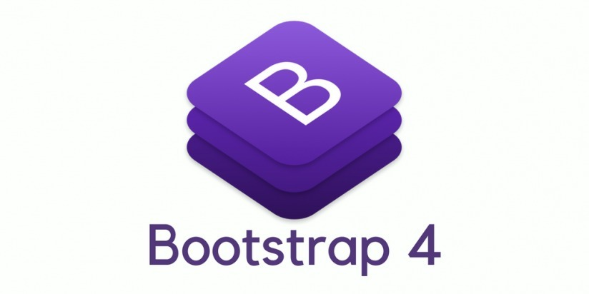






Tools or Technologies
IDE : IntelliJ
Type project : Maven Web Application
Server: Tomcat
Data base: Object Serialization
Subversioning: Git
Project Management: Trello
Programming Language: JSP, Servlet, JavaScript(jQuery, Ajax), Bootstrap

Slide 4
Challenges
Management of the time and handle the pressure
Choice of Tools
Synchronize project works

Slide 5
Difficulties
Database Integration

Slide 6
Project Demo Pictures

Slide 7
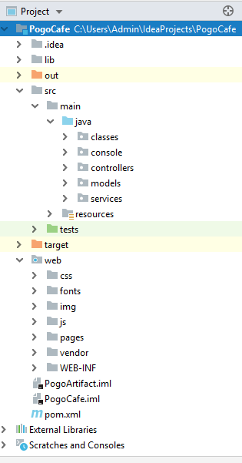

Slide 8
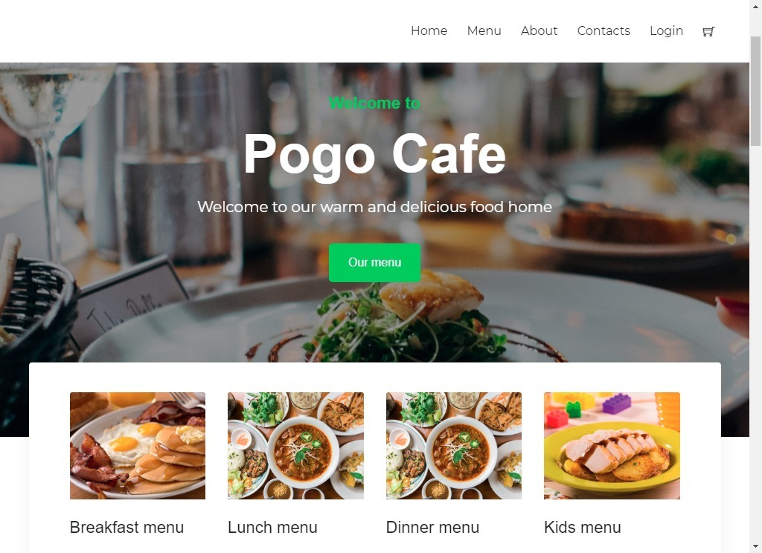

Slide 9
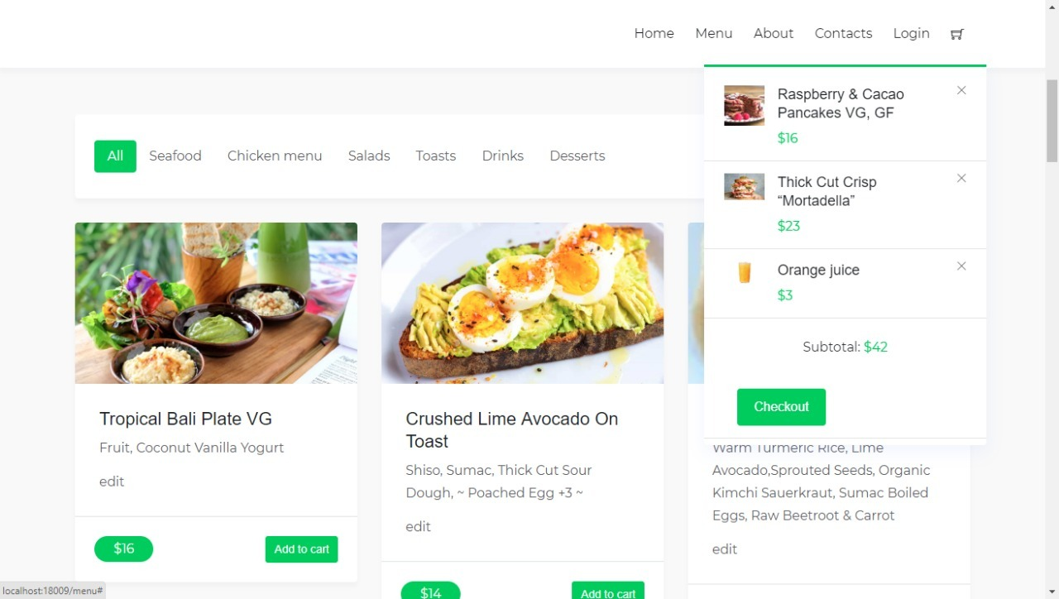

Slide 10
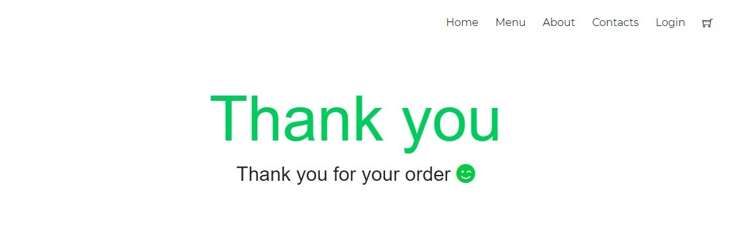

Slide 11
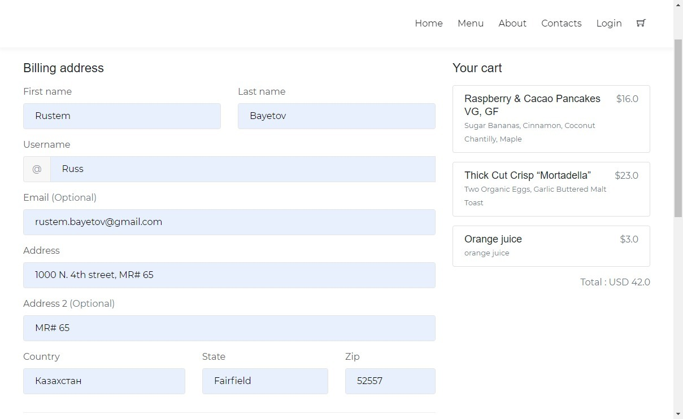

Slide 12
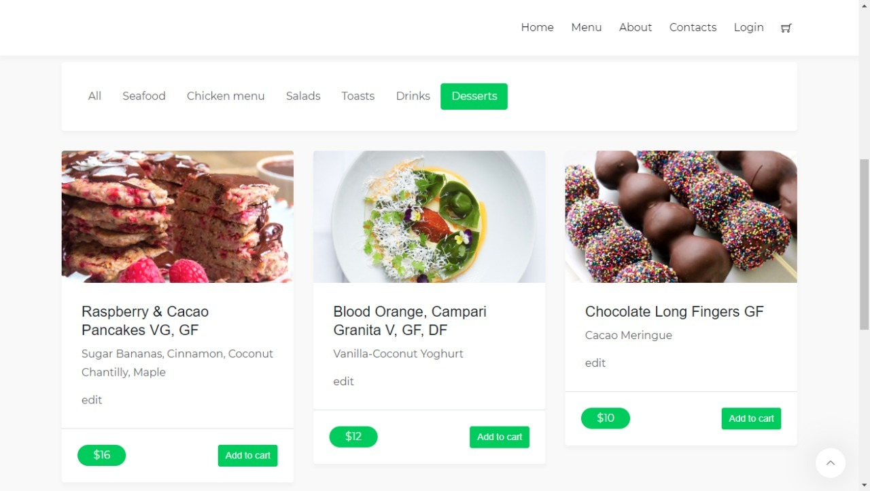

Slide 13
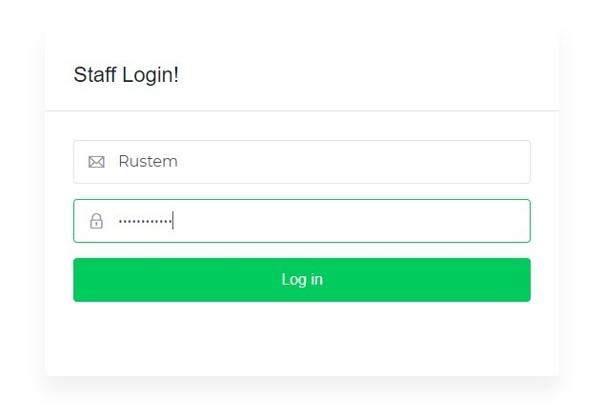

Slide 14
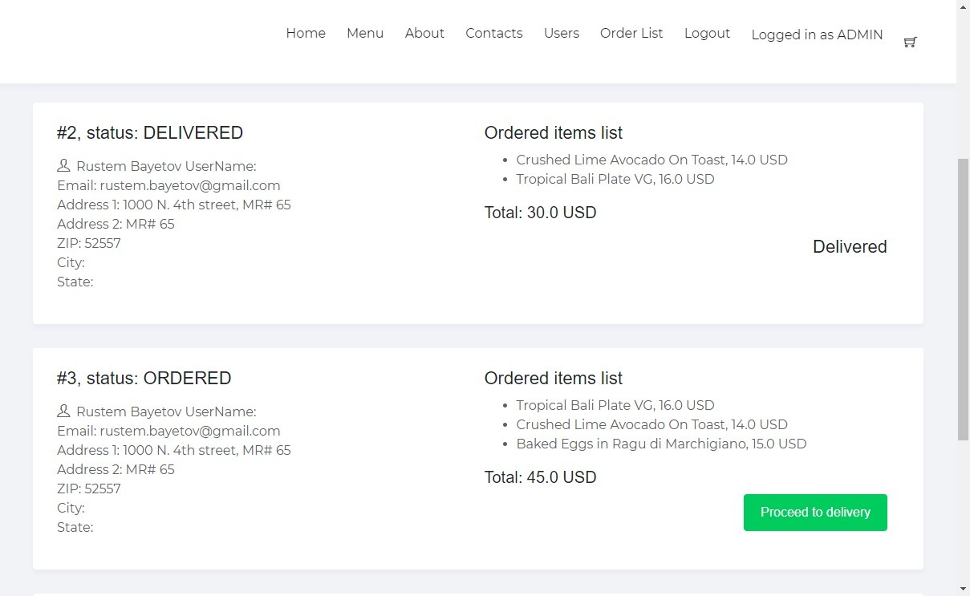

Slide 15
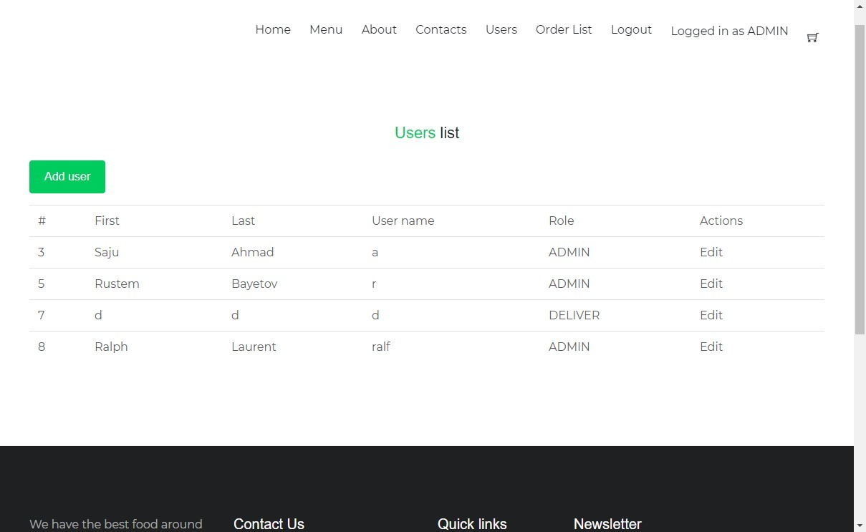

Slide 16
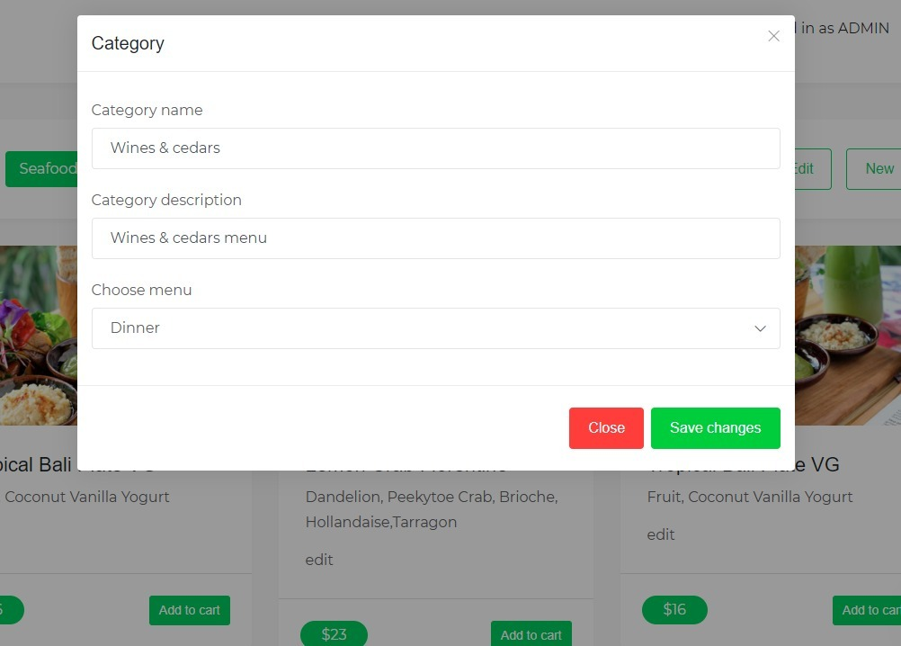

Slide 17
Summary
Idea behind the project is to use the technologies we learned in our course.
We have tried to developed a market ready professional web application that can be used by any restaurant in the real world

